Slide 1
Cell-cell adhesion cadherin–catenin complex:
A view of structure and dynamics by neutron scattering
Zimei Bu
City College of New York, CUNY
American Conference on Neutron Scattering, July 13-16, 2020

Slide 2

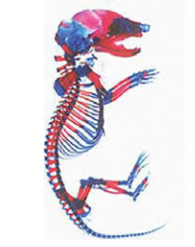
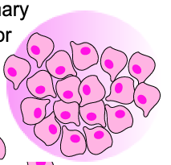
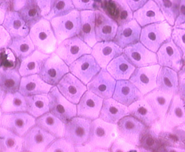
Cell-cell adhesion—animal tissues and organs
Cell adhesion
Cells
Tissue
Animal
Adherens junction complex in cell-cell adhesion

Slide 3
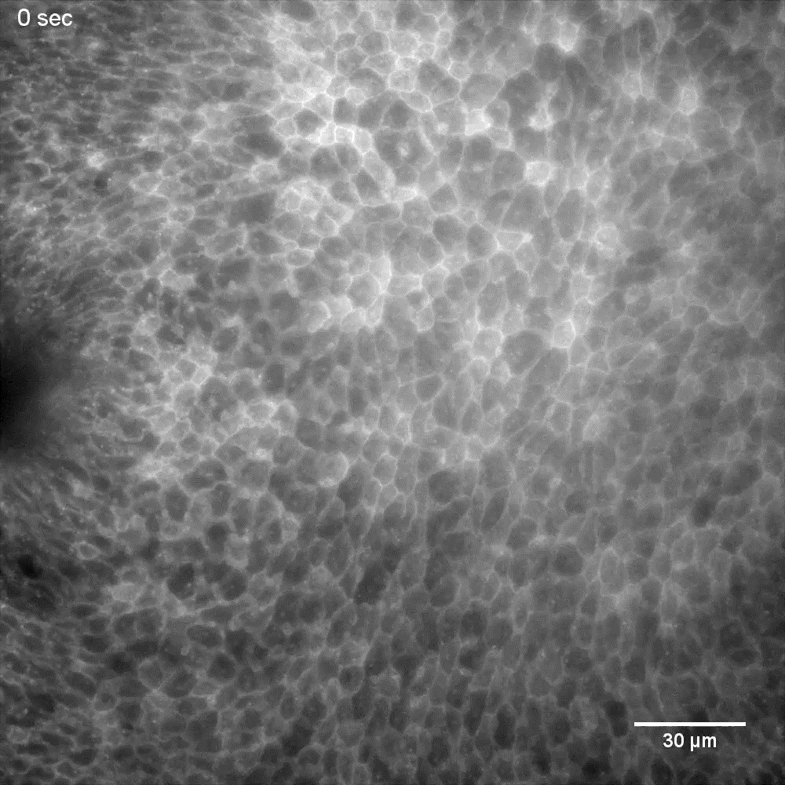
Adherens junctions are not static bonds
Click on movie
Mechanosensing and mechantranosduction control:
Cell collective movement
Tissue remodeling
Wound healing
Embryo morphogenesis
Actin and motors on actin provide the contraction force.

Slide 4
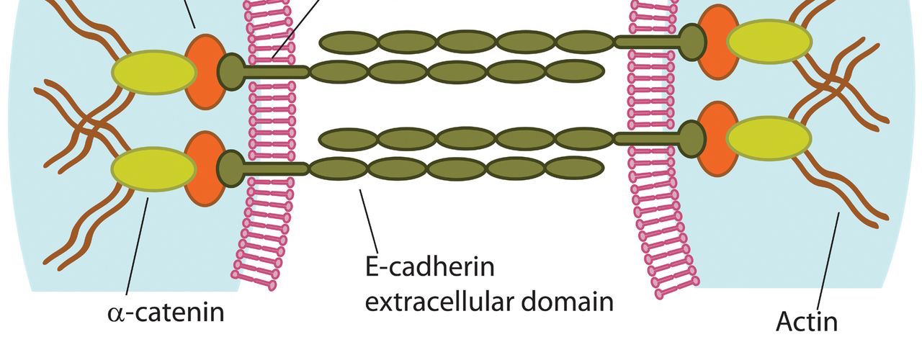
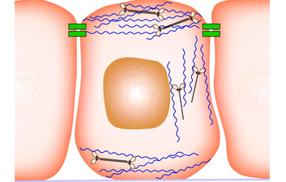
Adherens junction, a multiprotein complex
transmits mechanical stress from cell to cell—
Mechanosensors and mechanotransducers
The core component: E-cadherin, α-catenin, β-catenin

Slide 5
SEC-SAXS analysis of α-catenin dimer and monomer
Size Exclusion Chromatography - Small Angle X-ray Scattering
α-catenin dimer
α-catenin monomer
Stanford Synchrotron Radiation Laboratory
Notes:
Figure 1. Alpha-catenin and SEC-SAXS analysis. (A) Primary structure and domains in alpha-catenin. (B) SEC-UV of alpha-catenin. The fractions at elution volume 10.9 ml and 12.5 ml have molecular mass of xx and xx g/mol, respectively, as measured by static light scattering. (C) SEC-SAXS of the dimer and monomer peaks. (D) SEC-SAXS of the dimer peak. (E) SEC-SAXS of the monomer peak. Note: because (E) used a different SEC column from (C) and (D), the peak positions are shifted. The arrows in (D) and (E) marked the fractions of SAXS data selected for further analysis as shown Fig. 2 .

Slide 6
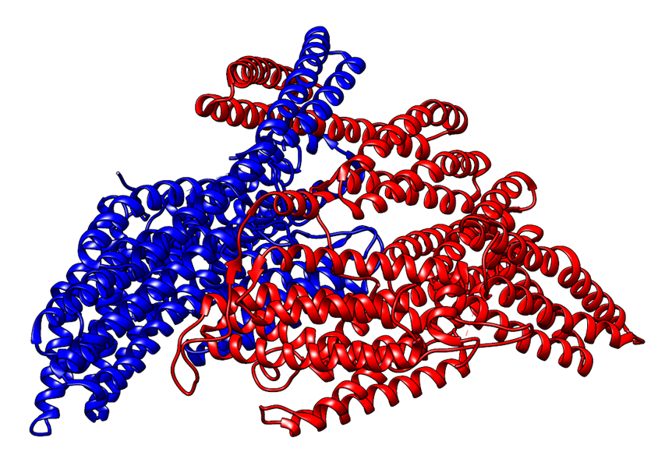
Comparing P(r) for solution α-catenin
monomer and dimer to the crystal structures
Monomer
Dimer
Notes:
Figure 2. (A) SEC-SAXS of the dimer (black) and monomer fractions (red). (B) P(r)s of dimer and monomer calculated from SAXS data. (C) Comparing P(r) of the SEC-SAXS monomer fraction (red open circle) with that calculated from crystal structure (one of the 4IGG protomers) after the disordered regions were reconstructed (red line). (D) Comparing P(r) of the SEC-SAXS dimer fraction (black open circle) with that calculated from crystal structure (PDB: 4IGG) after the disordered regions were reconstructed in the PDB file (black line).

Slide 7
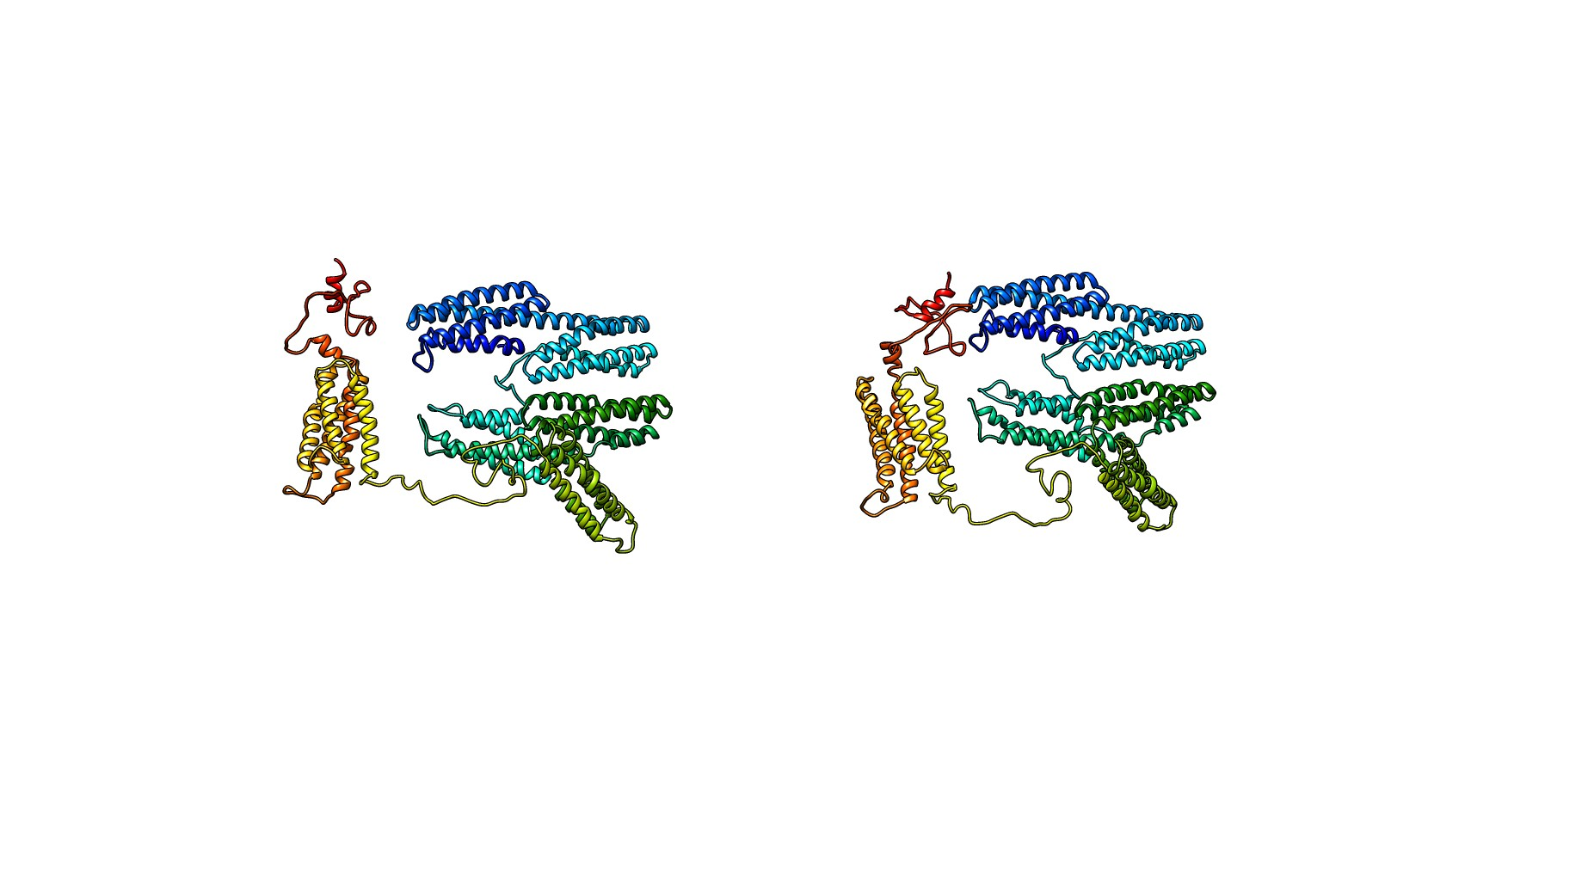
Alpha-catenin monomer in solution
Notes:
Figure 3. Solution structures of alpha-catenin monomer . (A) Structural models generated from SASSIE Monte Carlo simulation with best fit to the monomer fraction of experimental SEC-SAXS data (green and blue lines), with chi²<0.98. (B) Chi square of the fits of generated models to the monomer SEC-SAXS data. (C) Two structural models of open and closed alpha-catenin monomer with best fit to the experimental SAXS data.

Slide 8
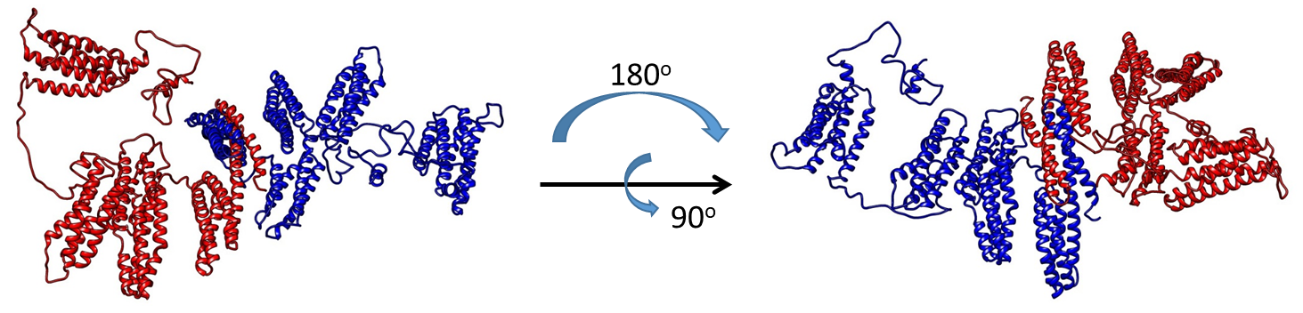
Alpha-catenin dimer in solution
Notes:
Figure 4. Solution structure of alpha-catenin dimer. (A) A representative structural model generated from SASSIE Monte Carlo simulation with best fit to the dimer fraction of SEC-SAXS data (red line) with Chi²<1.21. (B) Chi square of the fits of generated models to the dimer SEC-SAXS data. Two rounds of simulations are performed in order to minimize the Chi. (C) A representative alpha-catenin dimer with minimized chi square.

Slide 9
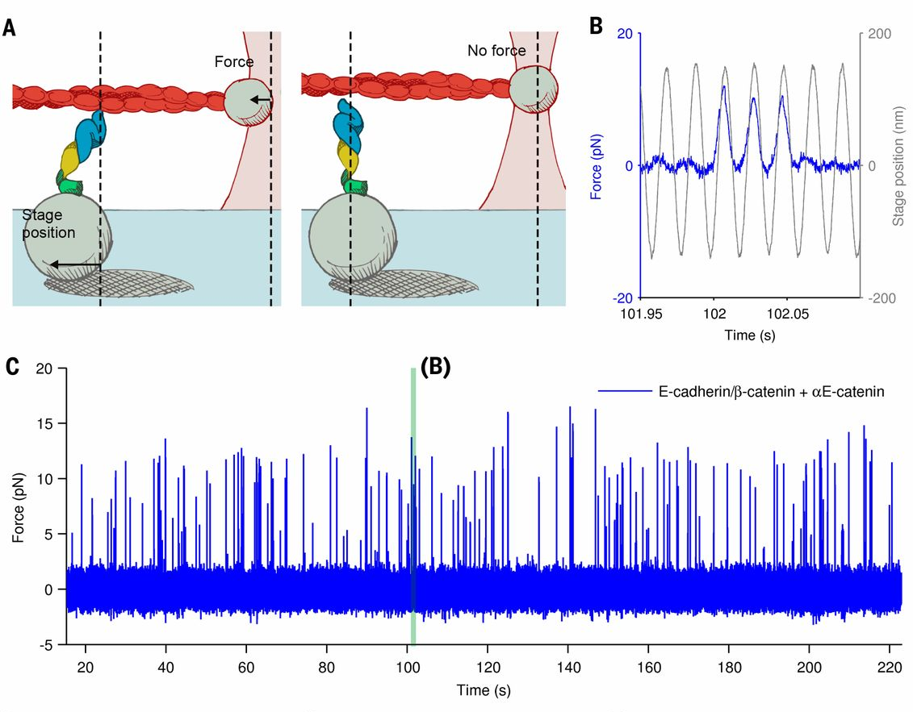
ABE complex— force sensitive binding to actin filament
Buckley et al, Science 346, 1254211 (2014).

Slide 10
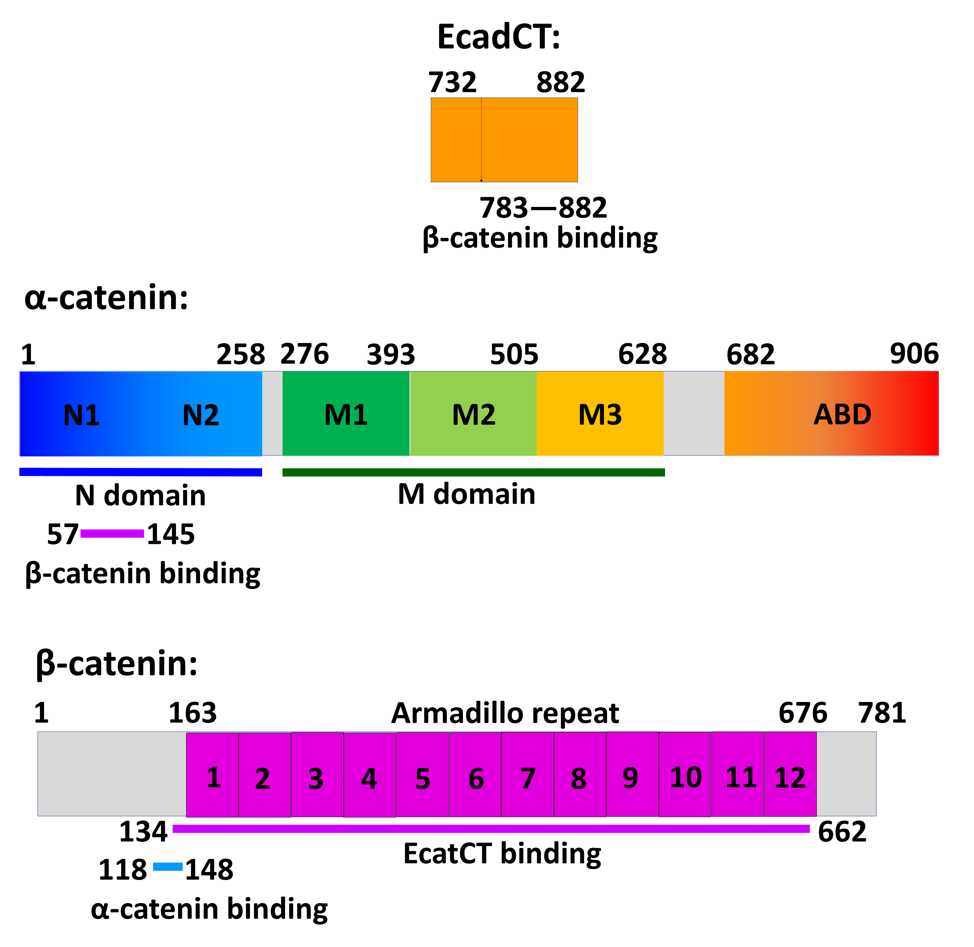
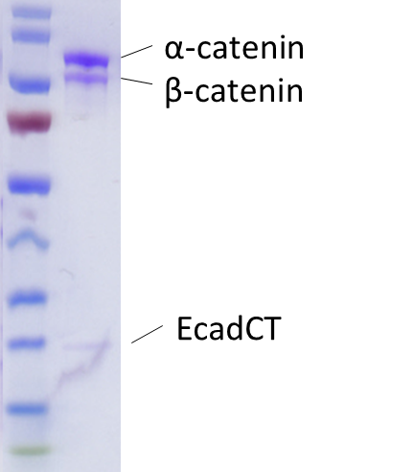
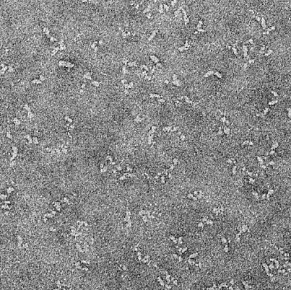
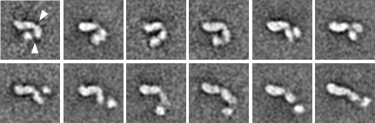
A
B
C

Slide 11
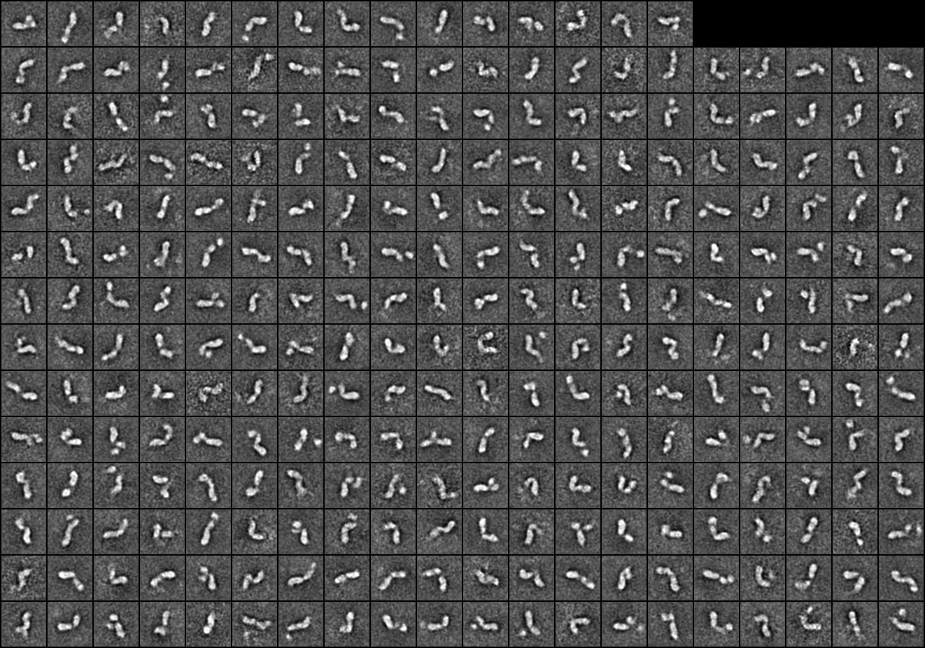
Negative stain electron microscopy on ABE complex
Martin Bush and Tom Walz
Rockefeller University
Notes:
Figure S1.

Slide 12
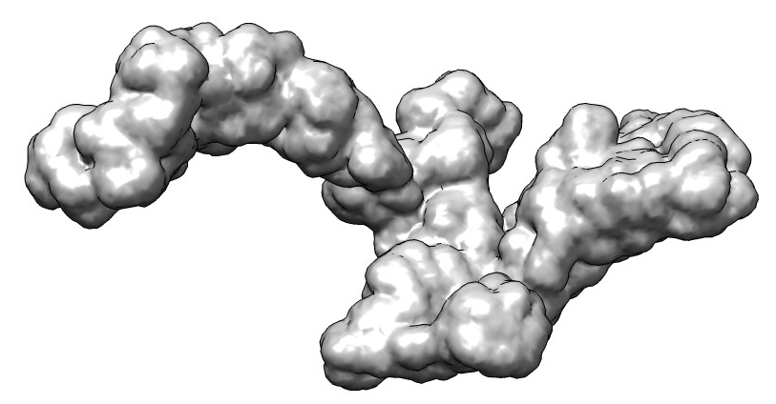
SEC-SAXS on ABE complex
A
B
C
D
E
Notes:
Figure 2. SEC-SAXS analysis of ABE complex. (A) Rg (red), I(q)_{min} (blue), and forward scattering intensity I(0) (black) of different image numbers measured across single peak of ABE. The arrow points to the SAXS data used for structural analysis shown in B-E. (B) I(q) vs. q plot. The line is the fit to generate P(r). (C) Guinier plot. (D) P(r) of ABE. (E) 3-D bead model of ABE reconstructed using the program Gasbor.

Slide 13
SANS + contrast variation
100% D₂O buffer
Hydrogenated mouse
+ Deuterated cat
Selectively deuterated α-catenin•β-catenin•E-cadherin (cytoplasmic)
ABE complex
Notes:
Figure 6. (A) Contrast-matched SANS on the ^{d}alpha-catenin·F-actin complex in 100% D2O buffer at the matching point of ^{d}alpha-catenin. The three panels are the scattering of the complex at different Actin to ^{d}alphacatenin molar ratios, with distinct correlation peak appears at molar ratio=3.8. The actin concentration is kept at 81.5 microM in all three panels. (B) The structure factor S(Q) of the F-actin bundle, generated by normalizing the I(Q) at molar ratio =3.8 (bottom panel) by the I(Q) at molar ratio=15.1 (top panel). (C) EM image of alpha-catenin assembled F-acitn bundle. (D) a structural model of alpha-catenin dimer between two actin filament.

Slide 14
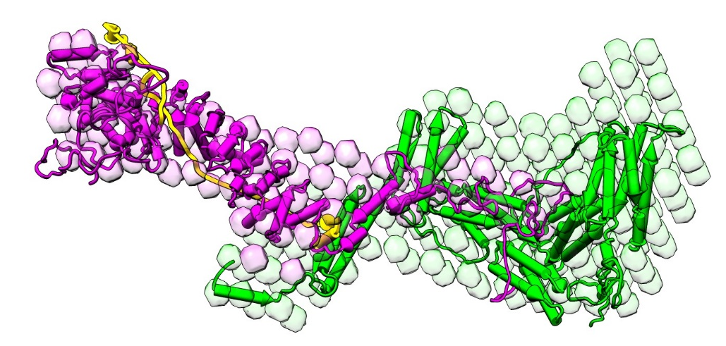
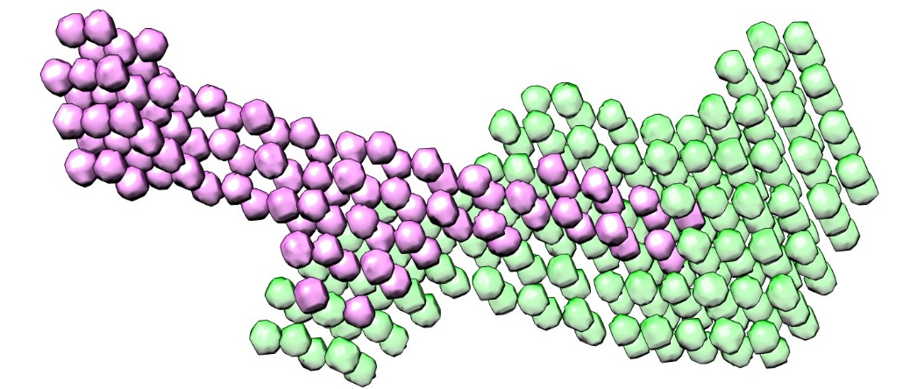
Contrast variation SANS on selectively deuterated ABE complex
A
B
C
D
^{d}A
^{h}B^{h}E
^{d}α-catenin^{h}β-catenin^{h}EcadCT

Slide 15
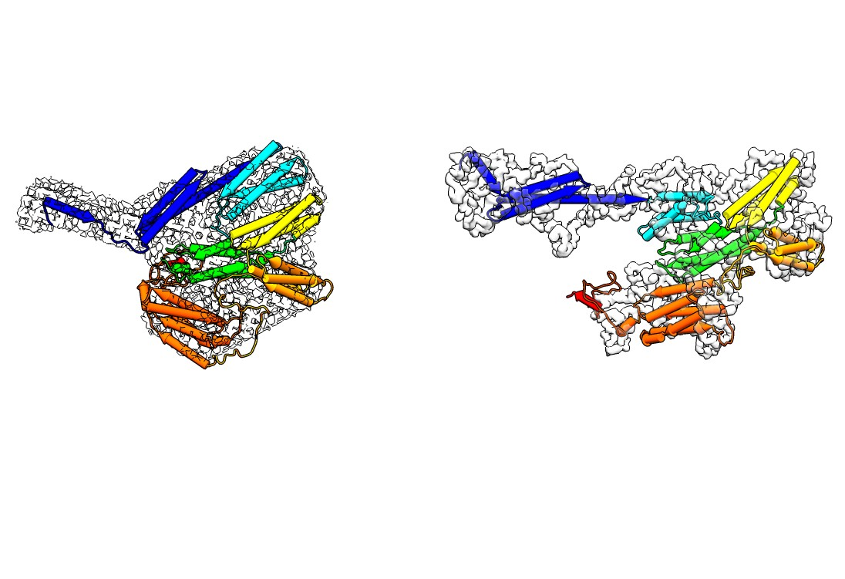
Conformation of α-Catenin within the ABE complex:
A Dynamic Ensemble of Multiple Domain Configurations.
A
B
C
N
D
N
M
M
ABD
ABD
α-catenin monomer in solution
^{d}α-catenin in ^{d}A^{h}B^{h}E complex

Slide 16
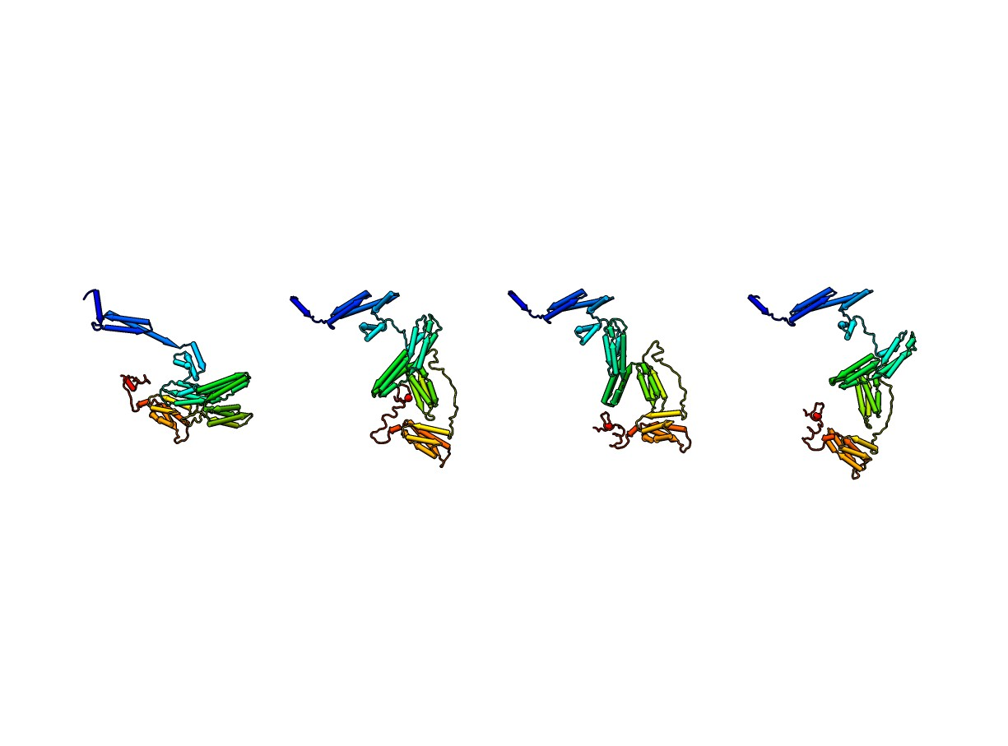
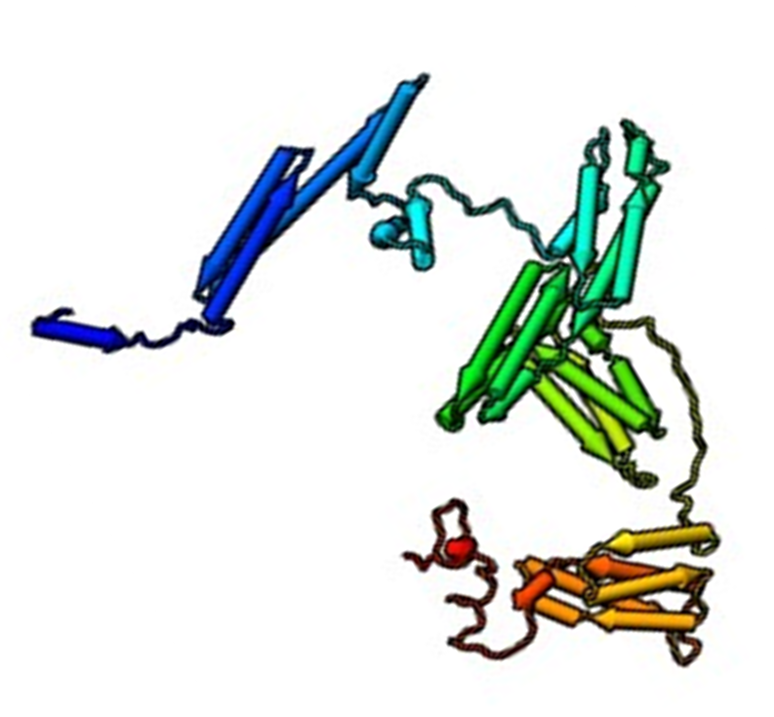
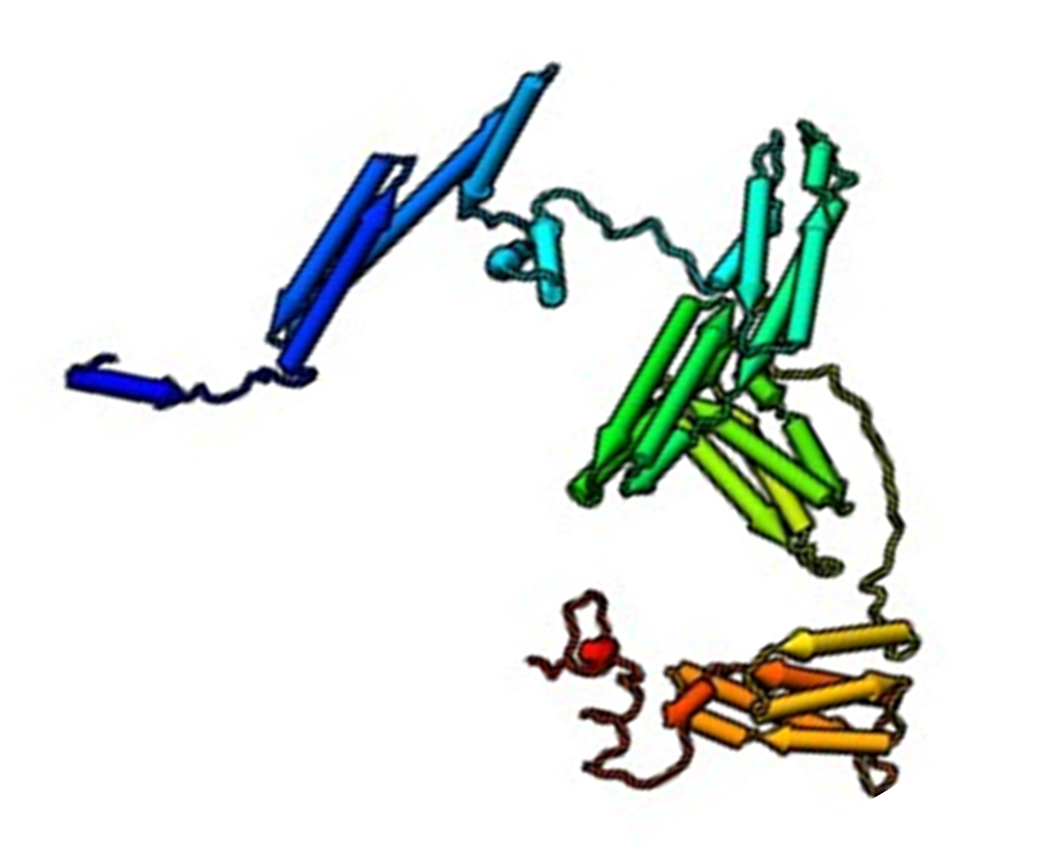
Conformational flexibility of ^{d}α-catenin within ABE complex
EOM analysis

Slide 17
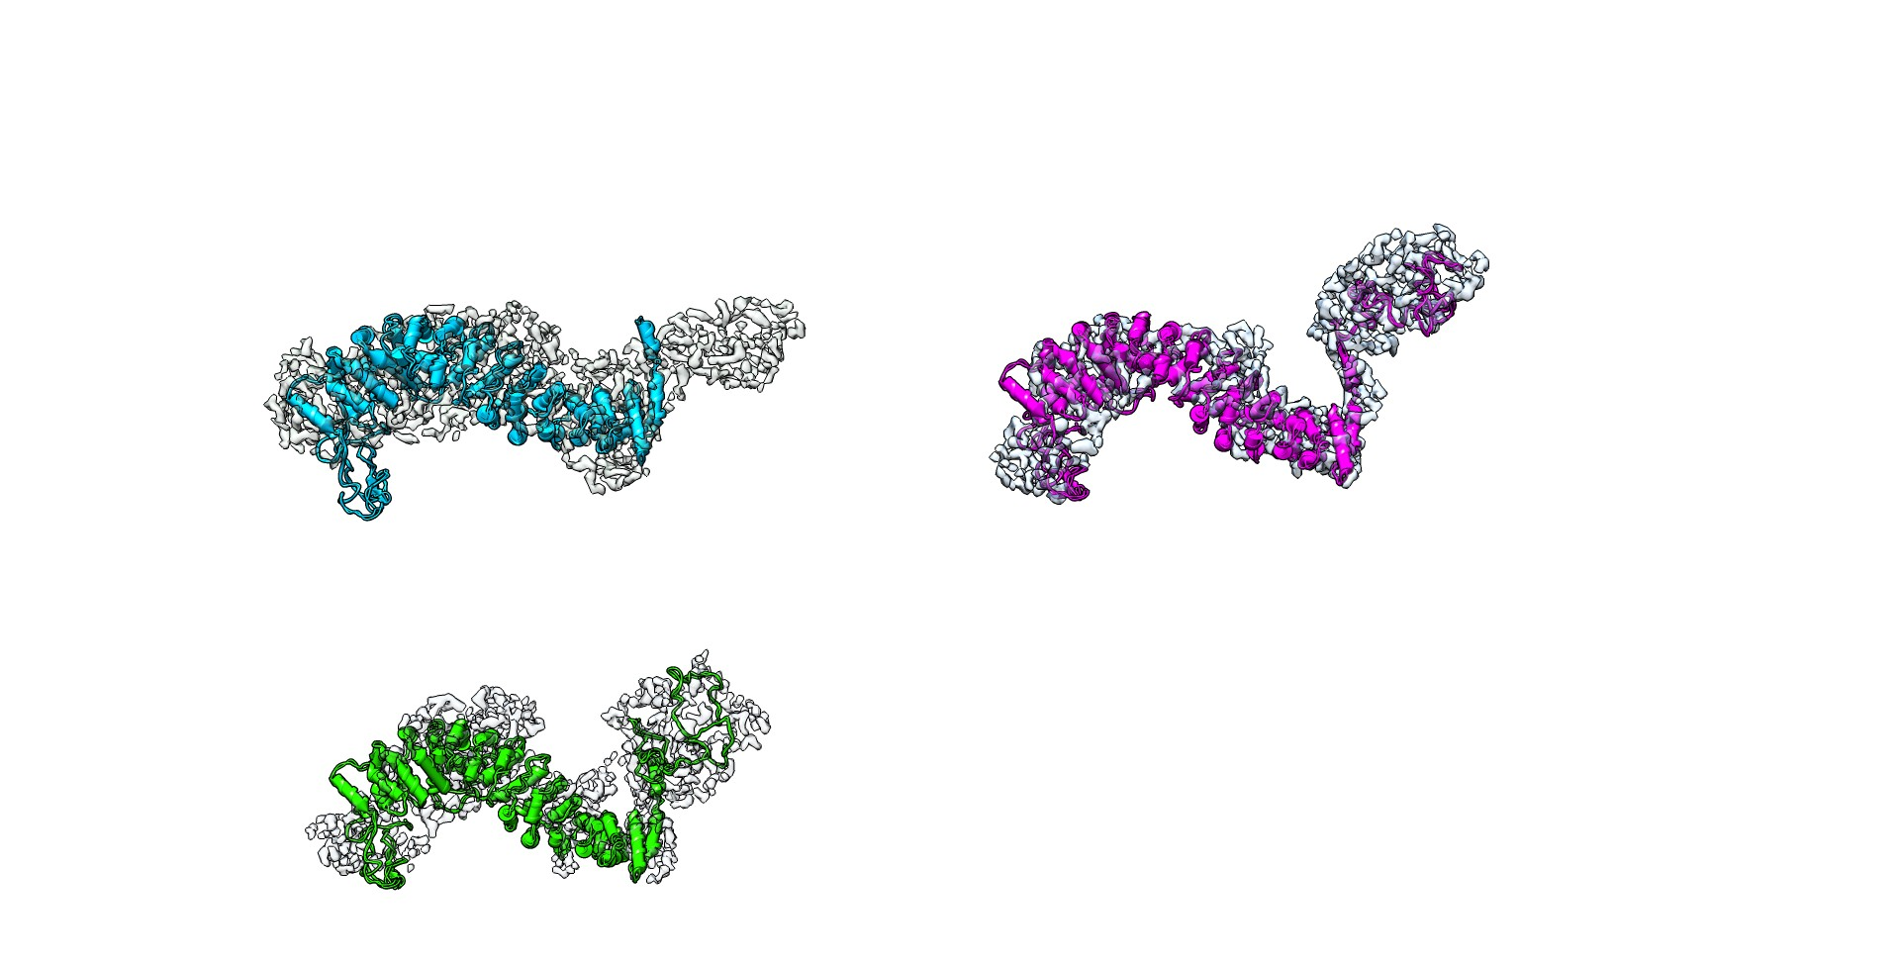
Conformation of β-Catenin within the ABE Complex
—the disordered N-terminal segment
D
E
F
β-catenin in solution
^{h}β-catenin in ^{h}B^{d}E
^{h}β-catenin in ^{d}A^{h}B^{d}E

Slide 18
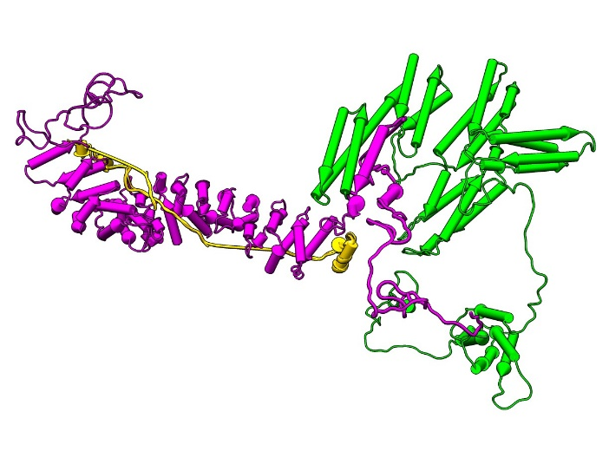
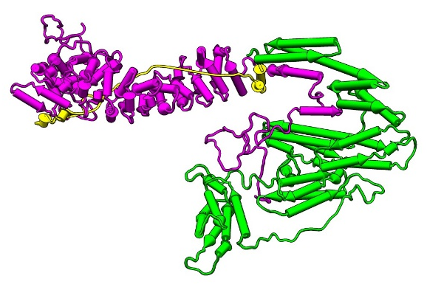
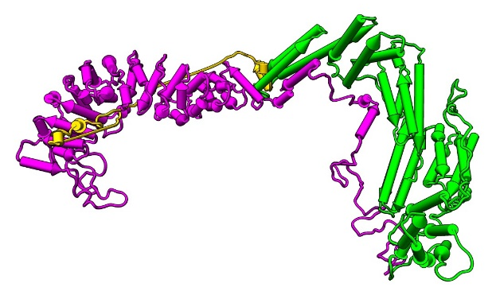
Flexible conformation of the entire ABE complex from SANS and SAXS
A
B
C

Slide 19
Conclusion from the structural study of ABE complex:
ABE complex exists as a spectrum of flexible conformations. The configurations of actin-binding domain range from folded in the complex to well separated from the main body.
In the spectrum of domain configurations, the well separated actin-binding domain conformations likely form transient bonds with actin under no mechanical tension.
Force shifts the population of ensemble to the conformations that favor strong actin-binding

Slide 20
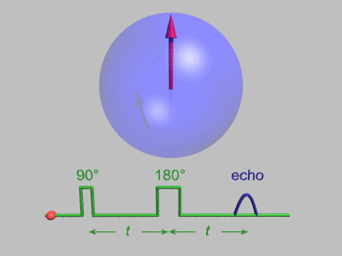
Neutron Spin Echo spectroscopy (NSE)
reveals protein nanoscale dynamics
Bloch sphere

Slide 21
NSE spectra of alpha-catenin
Notes:
Figure 7. Neutron spin echo spectroscopy of alpha-catenin dimer. Top panel: (A)-(C) intermediate correlation function I(Q,t)/I(Q,0) as a function of fourier time at different Q values. (D) Effective diffusion constant Deff(Q) (black square) obtained from 1st cumulant fit of the spectra shown in (A)-(C). Solid red line is the theoretical Deff(Q) using the coordinates of alpha-catenin dimer shown in Figure 4C, assuming the alpha-catenin dimer is a rigid body. Dashed red line is theoretical Deff(Q) assuming a.a. 836-906 in the dimer are moving.

Slide 22
Neutron spin echo spectroscopy
Decay rate of NSE spectra and
effective diffusion constant D_{eff}(Q)

Slide 23
Neutron spin echo spectroscopy
Our theoretical framework allows us to see nanoscale
internal motion
Mobility tensor H defines domain dynamics
Bu et al, PNAS, 2005
Farago et al, Biophys. J., 2010

Slide 24
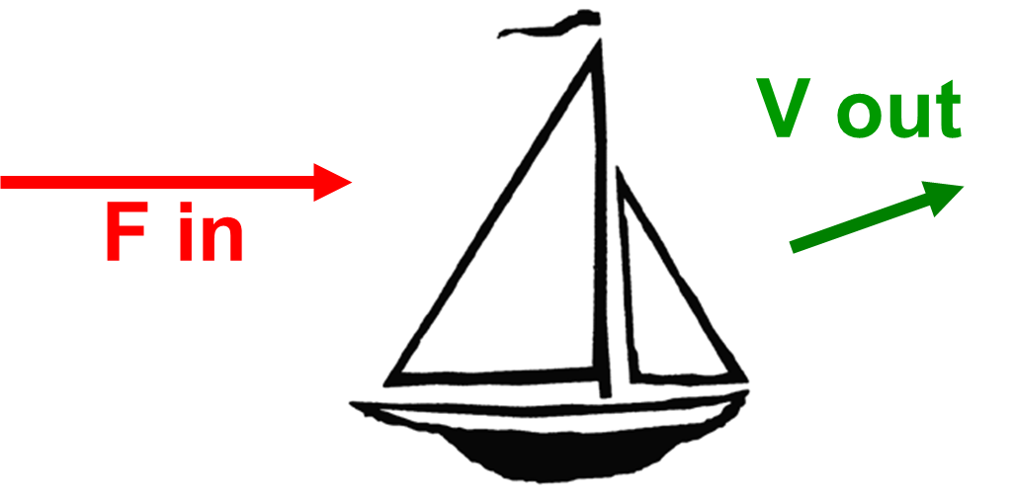
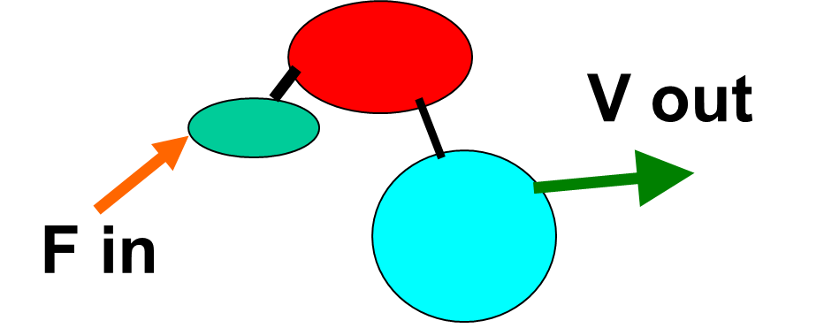
What is Mobility tensor?
v = H F
H is the mobility tensor, and yields the velocity of a domain given the force applied on it or another subunit. NSE yields H, given structure.
(Bu et al, PNAS, 2005)

Slide 25
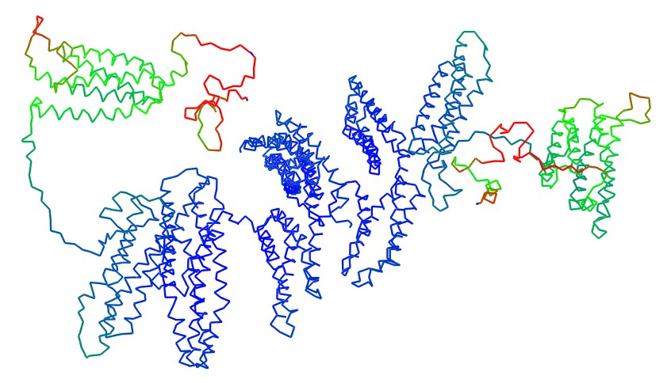
Neutron spin echo spectroscopy allows us to see
Nanoscale motion of the disordered tail of alpha-catenin
Nicholl et al, Biophys. J. 2019.

Slide 26




Acknowledgements
David J E Callaway
Iain D Nicholl
Bela Farago (ILL)
Collaborators:
Shuo Qian (ORNL)
William Heller (ORNL)
Chris Stanley (ORNL)
Tsutomu Matsui (SSRL)
Thomas Weiss (SSRL)
Funding:
NSF (MCB Molecular Biophysics)
Beam time awards at ORNL and SSRL (DOE BES)

